Slide 1
Predictive Models In ICU Databases
Alain, Darlene, Mariah
DATA 4381: DATA CAPSTONE
The University of Texas at Arlington
College of Science - Division of Data Science
Notes:
S

Slide 2
Updates!
01
02
03
Original
Reframing
New
Testing our original research question
Coming up with a new research question
Testing out our broader research question
Notes:
Using the eICU demo from physionet

Slide 3
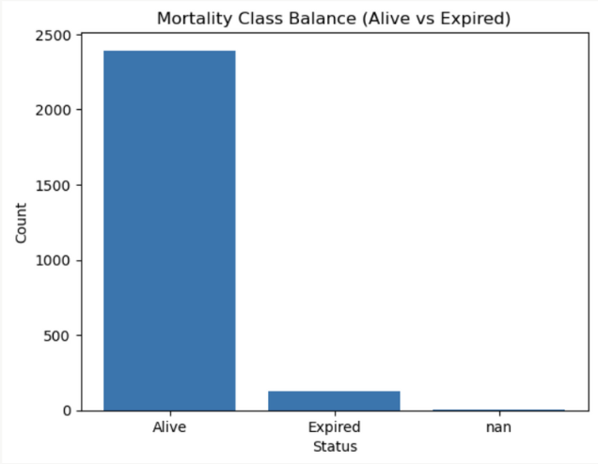
Refresh!
Do predictive models for ICU mortality or readmission risk exhibit bias across demographic groups or hospital systems?
Target: Mortality - 0 if alive, 1 if died
 | Precision | Recall | F1
0 | 0.92 | 1 | 0.96
1 | 0 | 0 | 0
Accuracy |  |  | 0.92
Macro Avg | 0.46 | 0.50 | 0.48
Notes:
Using the eICU demo from physionet

Slide 4
What columns to keep! Lit review time!
Columns
Patient Demographics | age, gender, ethnicity, unittype
APACHE Metrics | acutephysiologyscore, apachescore, apacheversion
Predicted Outcomes | predictedicumortality, predictedhospitalmortality
Actual Outcomes | actualicumortality, actualhospitalmortality
Early Vital Signs | hr_mean, rr_mean, sao2_mean, temp_mean, map_mean
Columns
labs 24hr | glucose_mean, creatinine_mean, bun_mean, sodium_mean, potassium_mean
hospital context | region, managementsystem
provider context | physicianspeciality
predicted vs actual outcomes | predictedhospitalmortality, actualhospitalmortality, predictedicumortality, actualicumortality
Columns
Early Labs | glucose_mean, creatinine_mean, bun_mean, sodium_mean, potassium_mean
Discharge Context | hospitaldischargestatus, hospitaldischargelocation
Readmission Setup | predictedicumortality, predictedhospitalmortality
Underlying Conditions | diabetes, cirrhosis, aids, immunosuppression, metastaticcancer, lymphoma
Vitals 24hr | hr_mean, rr_mean, sao2_mean
Notes:
Summary of Articles
PMC9222812: Integrating structured and unstructured ICU data with topic modeling improves mortality prediction compared to traditional machine learning approaches.
Nature Scientific Reports 2020: A hybrid CNN-BiLSTM neural network predicts ICU patient mortality using 24-hour vital sign trends with high accuracy.
PMC10796141: Common ICU severity scores like APACHE and SOFA may exhibit prognostic bias, highlighting the need for more personalized prediction tools.
Frontiers in Cardiovascular Medicine 2025: Routine blood tests and vital signs can effectively predict mortality in ICU heart failure patients, offering a practical alternative to complex diagnostics.
Bias Merged Tables
it’s important to be fair and consider people’s backgrounds like their age, gender, and race (demographics) when using AI or computer scores to judge patient risks
these clinical risk scores don’t always work equally well for everyone; for example, they may be less accurate depending on someone’s age, sex, or race in the ICU
Readmission Merged Tables
if your heart rate, breathing rate, or oxygen levels change a lot, you’re more likely to be sent back to the hospital after leaving the ICU
high levels of BUN and creatinine (which show if your kidneys are under stress) mean you’re more likely to need to come back to the hospital after the ICU
health problems like diabetes, liver disease (cirrhosis), or weak immune systems are more likely to be readmitted after the ICU
Mortality Merged Tables
basic body signs—like heart rate, blood pressure, oxygen levels, and breathing rate can be strong warning signals for risk of dying soon in the icu
certain blood tests like kidney function (creatinine and BUN), and levels of sodium, potassium, and glucose are very important for predicting who is most likely to survive

Slide 5
Merging Tables
Darlene’s attempt merging in SQLite

Slide 6
Final Base Tables Overview
01
02
03
Mortality
Readmission
Bias
Patient info & some demographics
APACHE (predictions & outcomes)
24-hr vitals/labs
Patient info & some demographics
Discharge info
Hospital setup
24-hr vitals/labs
Demographics
Provider
Hospital context for fairness analysis

Slide 7
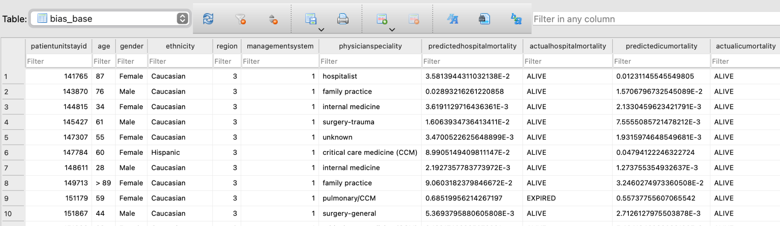
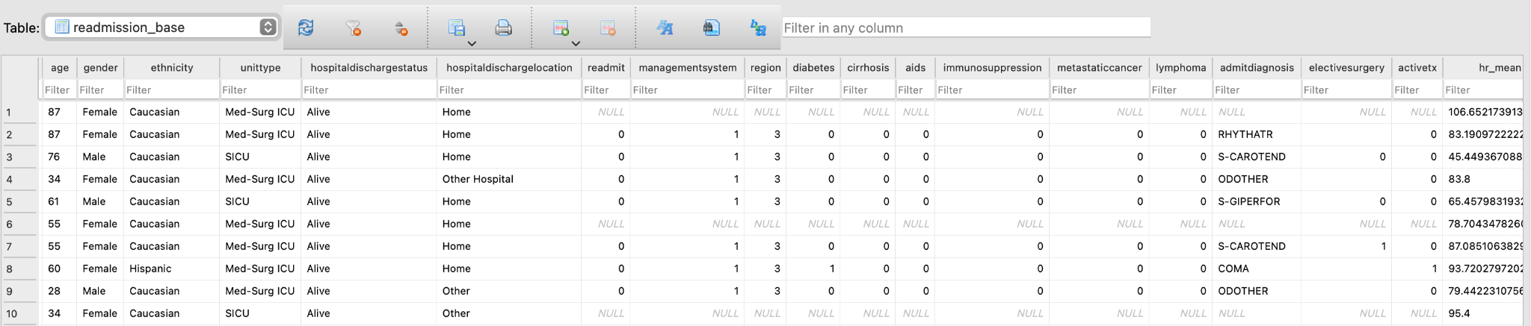
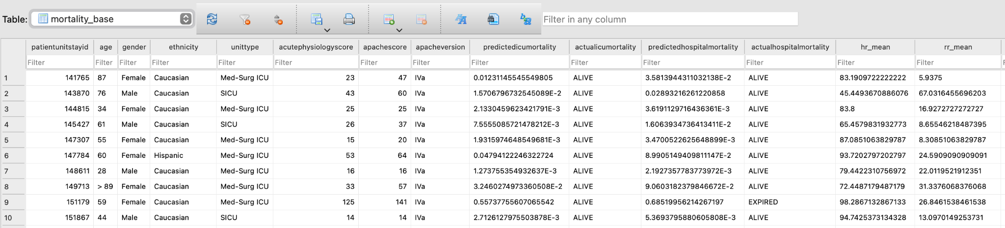
BIAS
READMISSION
MORTALITY

Slide 8
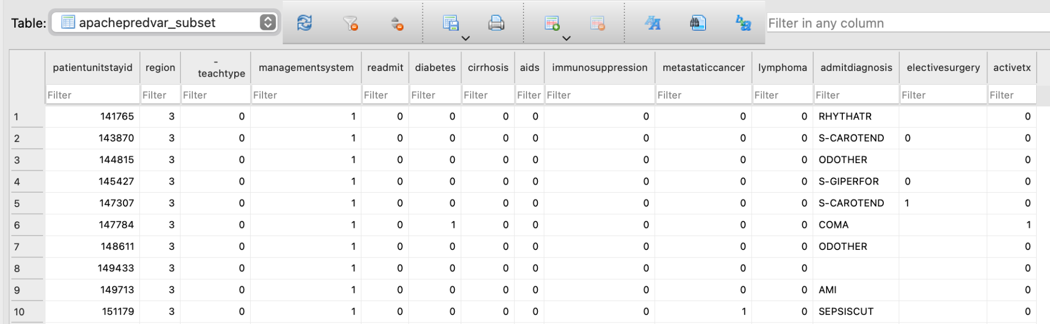
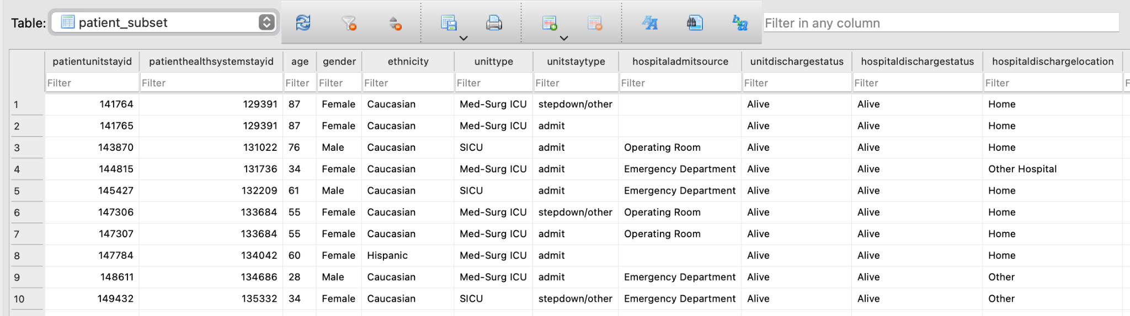
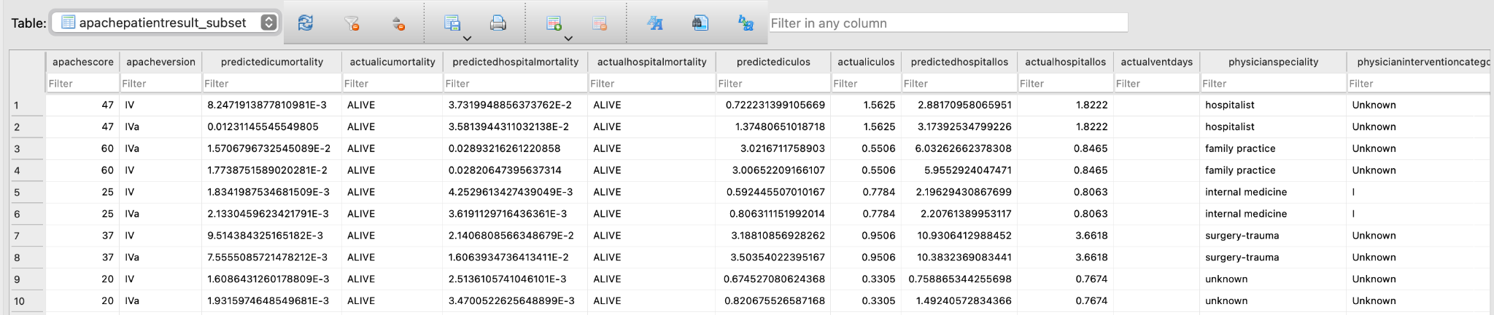
How I Got There: Subsets
Created subsets to keep one row per ICU stay
Notes:
Divide them by
Interaction term? Becomes its own predictors
Comorbidities x vitals (apache score)
Feature engineering?

Slide 9
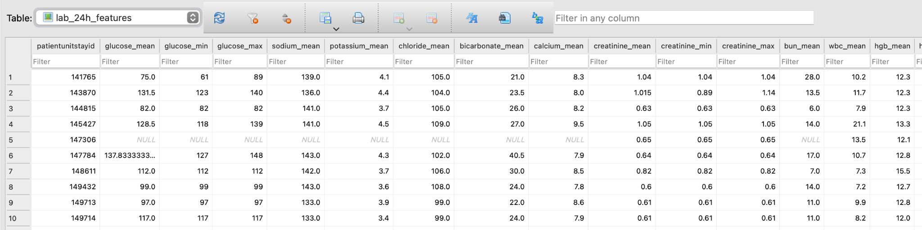
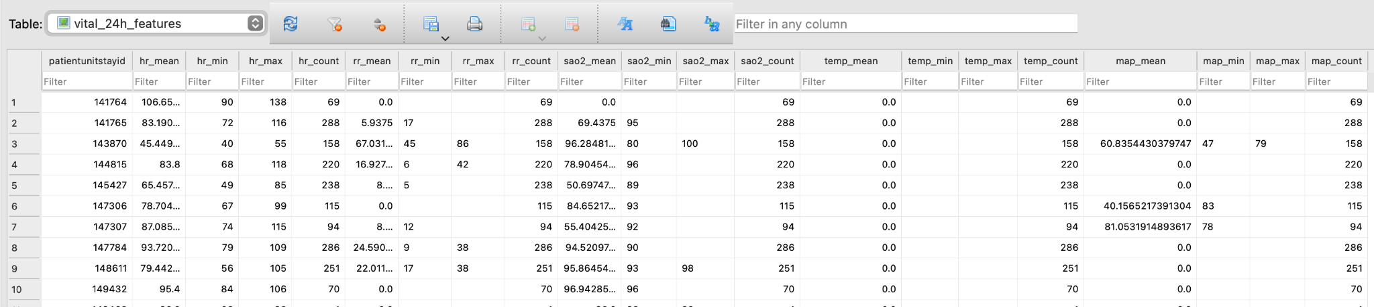
How I Got There: Built 24-hr views for labs & vitals
Created views summarizing the first 24-hour vitals/labs in the ICU
The views compute mean/min/max for key vitals (HR, RR, SaO₂, Temp, MAP) and core labs (glucose, Na, K, creatinine, BUN) → one summarized row per stay

Slide 10
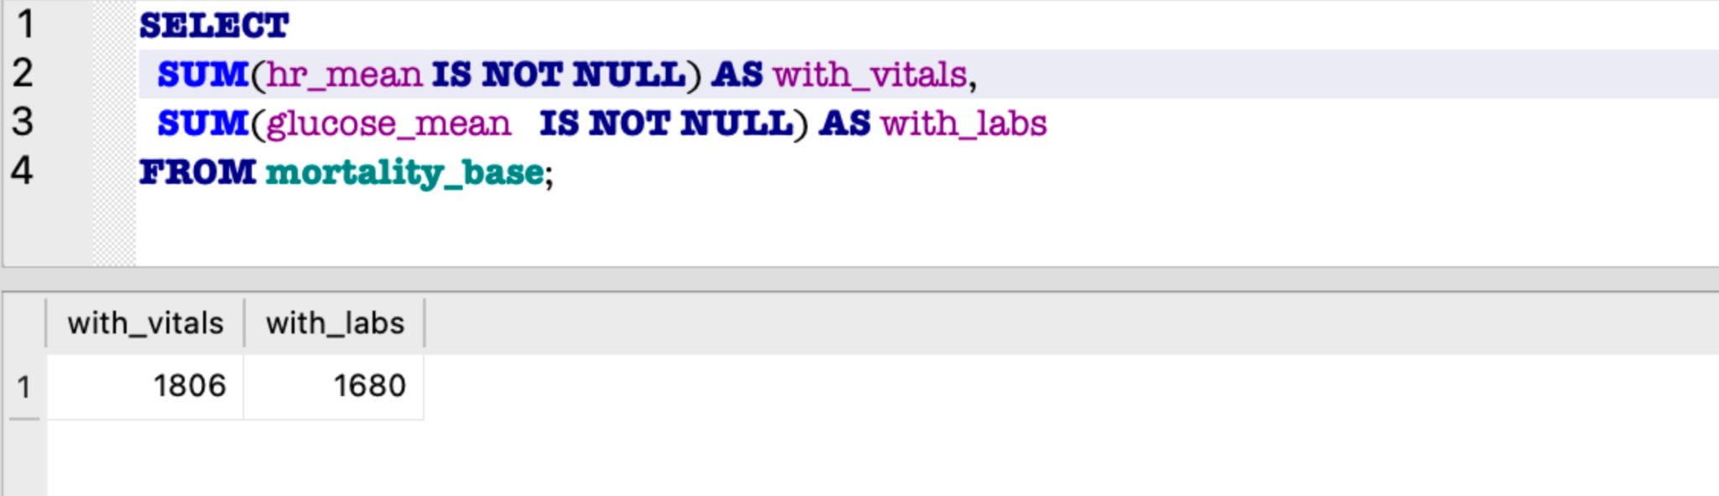
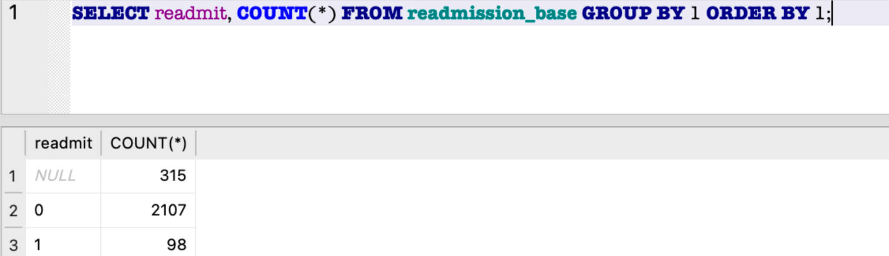
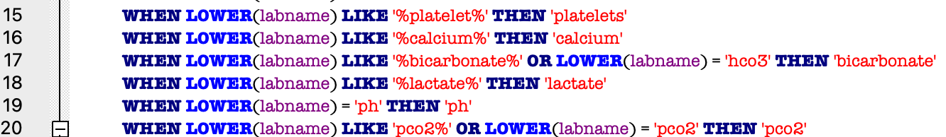
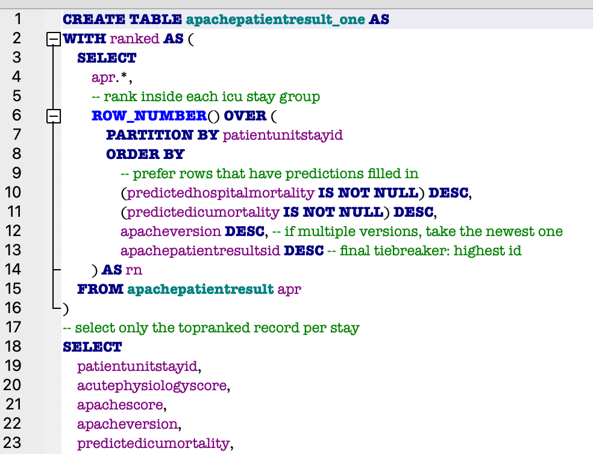
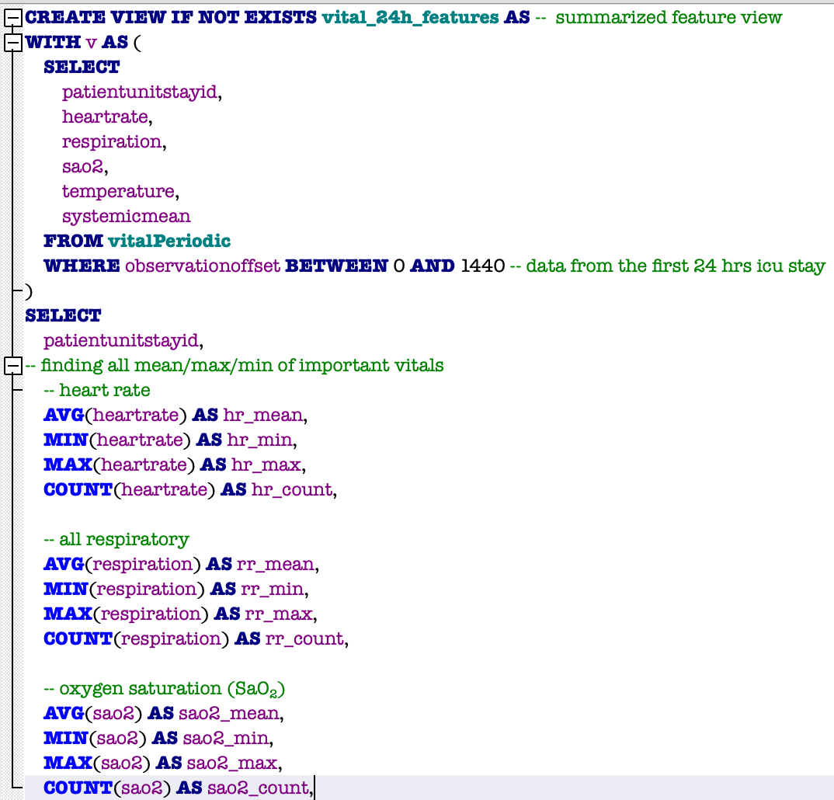
The Big Challenges I hit (& what I learned)
Deduping: learned PARTITION BY to pick the best record per ICU stay.
24-hr window: kept only first-day data (0–1440 min) to stay consistent
Join choices: used INNER vs LEFT joins carefully to keep all valid patients.
Cleaner pipeline: subsets + views = organized, reusable SQL (not one giant query).

Slide 11
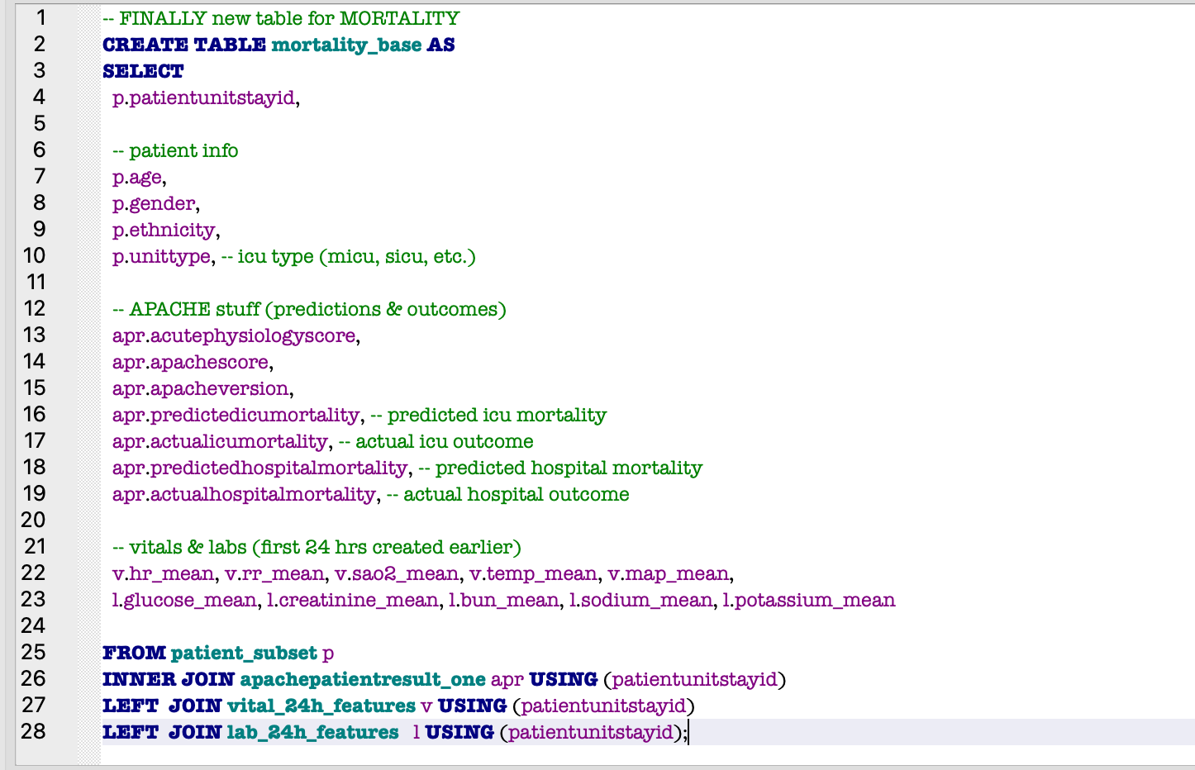
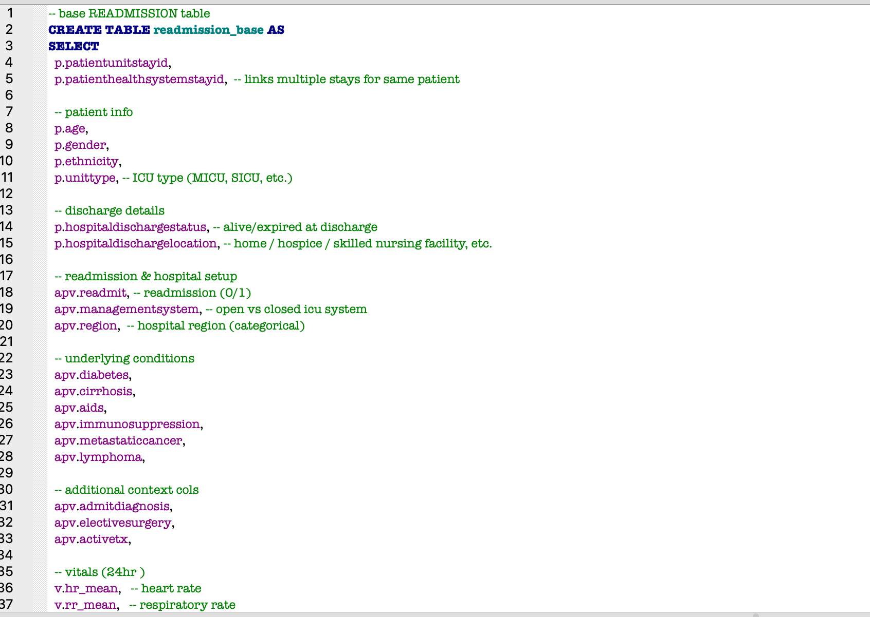
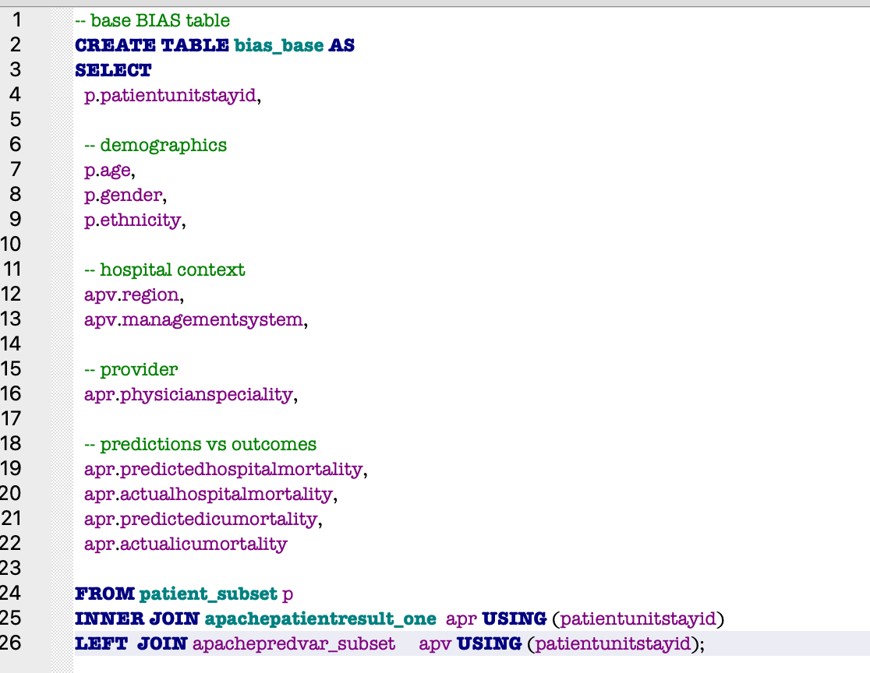

Slide 12
Mortality Merged Model
Data Cleaning & Preprocessing
Model Setup
Fixed age format (e.g., “>89” → 90)
Made binary mortality label (Expired = 1)
Removed impossible vitals (<10 MAP, 0 HR, SaO₂ < 50 %)
Imputed missing labs/vitals by ICU type (median)
Normalized skewed labs (log + winsorization)
Model: Random Forest Classifier
Target: actualmortality (Expired vs Alive)
Features: demographics, APACHE scores, 24-hr labs & vitals
Split: 70/15/15 (train/val/test, stratified)
Metrics: Precision, Recall, F1, AUROC
Tuned probability threshold on validation

Slide 13
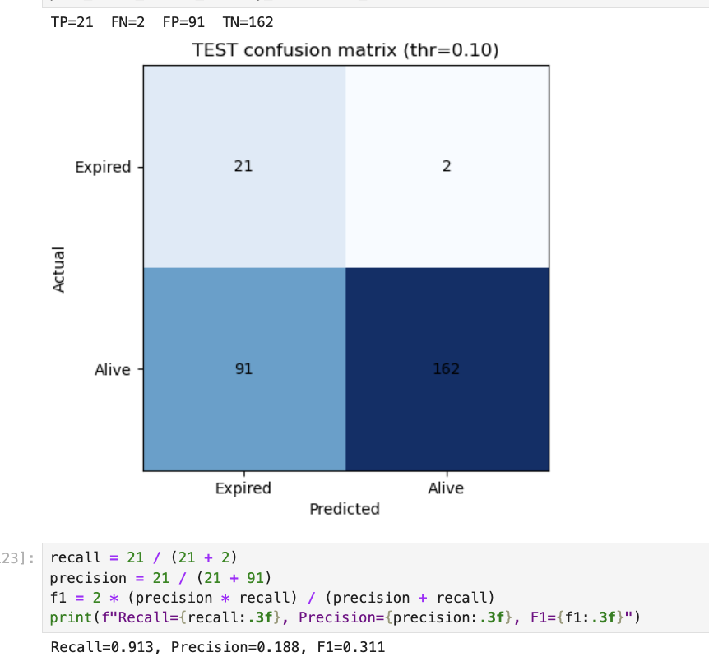
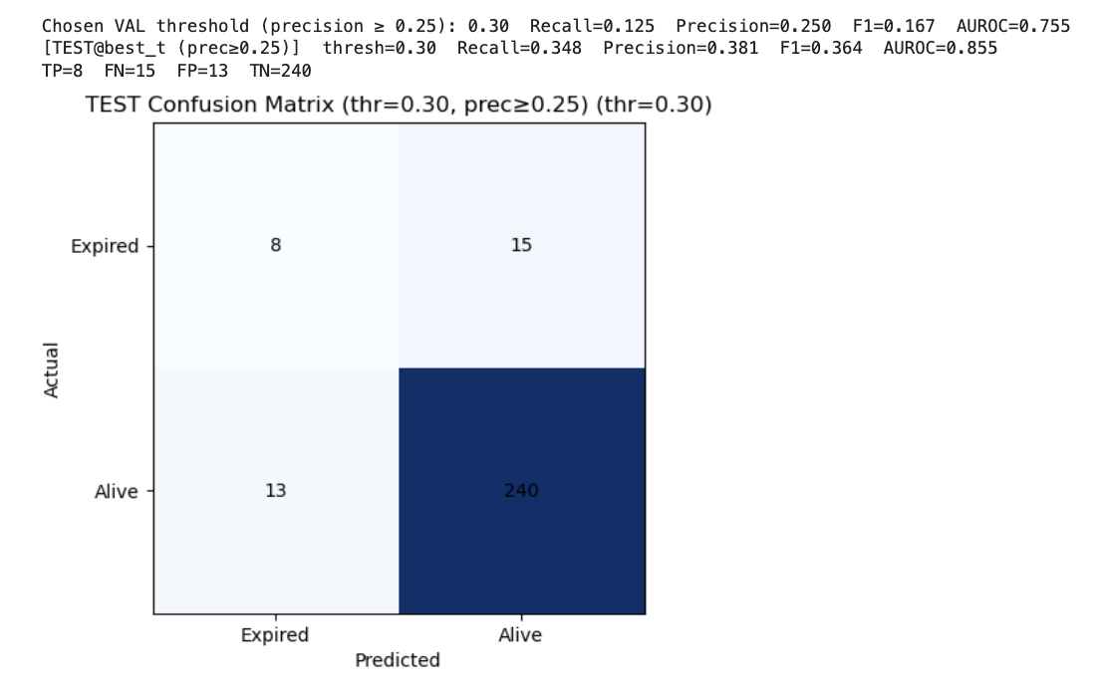
Threshold Tuning & Results
t = 0.10: Recall = 0.91, Precision = 0.19 → high sensitivity, many false alarms
t = 0.30: Recall = 0.35, Precision = 0.38, AUROC ≈ 0.86 → more balanced
Shows recall-precision trade-off
Notes:
Probably wise to drop predicted and actual outcomes… the majority class (alive = 0) places heavy class weight
Next:
Use Mars’ df but tweak the initial 24 hr labs/vitals using min/mean/max (maybe just use one of em and then drop the rest)
APACHE is based on 12 acute physiological variables, with the worst value in the first 24 hours of admission used
Drop the winsorization cols and try to get the range more normalized… no more capping on the ranges

Slide 14
Takeaways & Next Steps
Key Takeaways:
Random Forest achieved decent AUROC (~0.86) but still affected by class imbalance
Lower thresholds improved recall but reduced precision, highlights trade-off
Cleaning and feature scaling steps worked, but more EDA needed on distributions
Next Steps:
Redo EDA & Preprocessing to check for outliers, skew, and feature correlations
Feature Importance Analysis to identify which vitals/labs influence mortality most
Hyperparameter Tuning (n_estimators, max_depth, class_weight)
Try Logistic Regression & XGBoost for comparison
Evaluate Subgroup Bias (gender, ethnicity, ICU type)

Slide 15
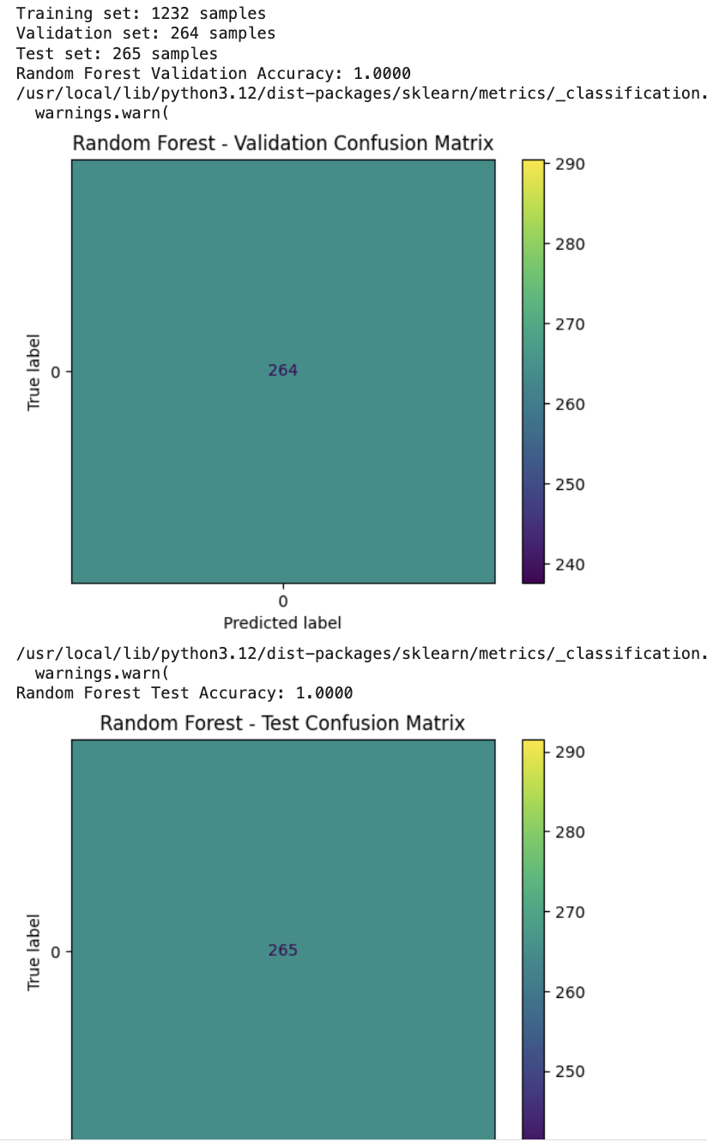
Random Forest and Overfitting
Encoded target variable (Actual ICU Mortality)
Encoded categorical variables
Converted float values into integers
Model wasn’t picking up minority class??
Notes:
Alain is in pain
Lol
Smote is my favorite technique but unfortunately not able to use
Because we were unable to use smote, we realized something yesterday. Ok hear us out…

Slide 16

We realized the real lies with our real eyes
Notes:
Mars: So hear us out…
ALL THREE OF US: READ IT ALL TOGETHER

Slide 17
Maybe an unbalanced dataset isn’t a problem…
Why it may be
Why it may not be
Bias towards majority class
Evaluation can be misleading
Accuracy is not the best metric to use
Reflects real world frequencies
Some metrics are robust to imbalance
Balancing can distort interpretation

Slide 18
Where do we go from here?
Question
Old Research Question
Models
New Research Question
Issues with dataset & columns
Not broad enough
Tuning
Performance
Bias
Bias/Fairness Check

Slide 19
Reframing
Old Question | New Research Question
What patterns of performance disparity or bias are present in ICU mortality and readmission models when comparing patients of different demographics or hospital contexts, and how might these nuances influence clinical decision-making? | Can we predict ICU patient poor outcomes (death or readmission) using demographic, clinical, and physiological data from the dataset, and how does imbalance affect model performance?
Notes:
A proper binary classification model and then feature importance after

Slide 20
New data frame created
Darlene’s Dataset | Mine
2 days | 7 hours
3 target variables (readmission, hospital death, ICU death) | Merged the minority group into bad_outcomes ~ 293:2227
Created subsets by ranking | Aggregated features using mean or max
Essential vitals only, focused on details | Added comorbidities and intake/output
Kept prediction variables (i.e. predictedHospitalMortality) | Took out prediction variables to prevent data leakage
Min/Mean/Max first 24 hour window labs/vitals | 24 hour vital average, stdev
2520 rows, 57 columns | 2520 rows, 60 columns
Notes:
We were able to reduce the many tables and features

Slide 21
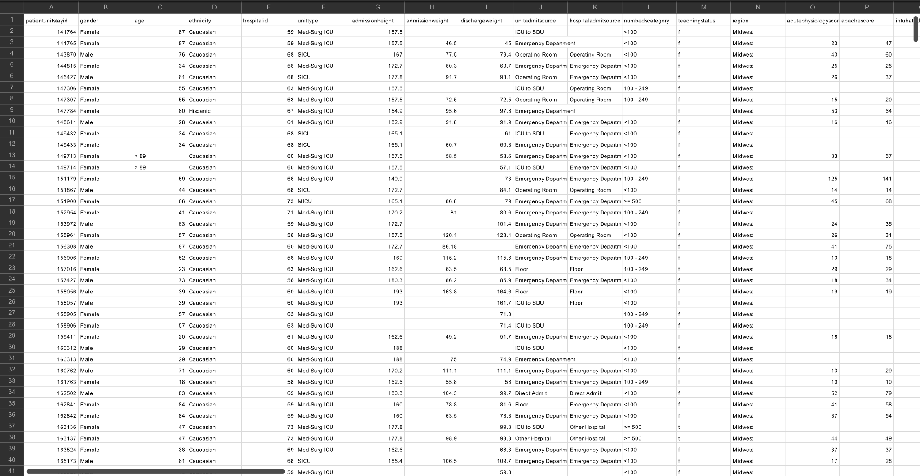
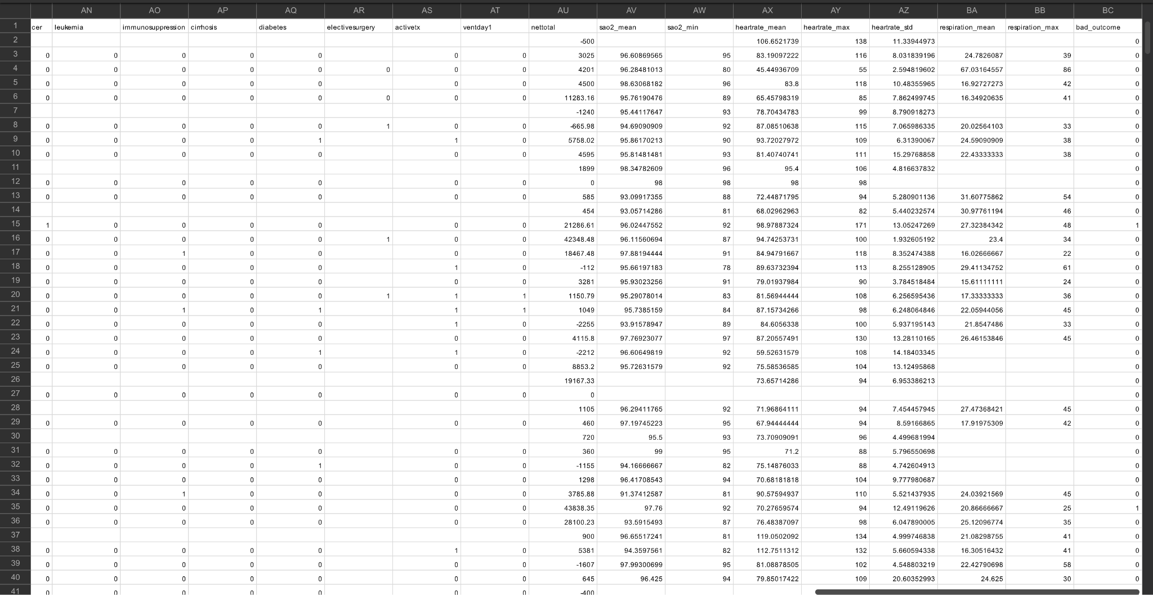
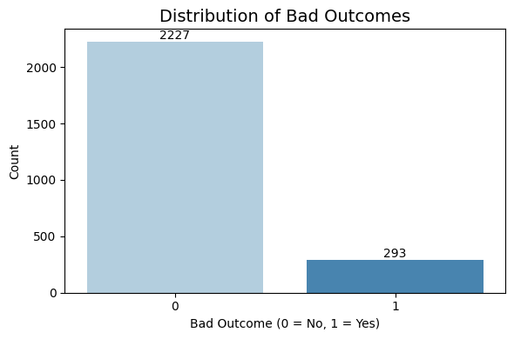
Notes:
88% good outcome and 11% bad outcome

Slide 22
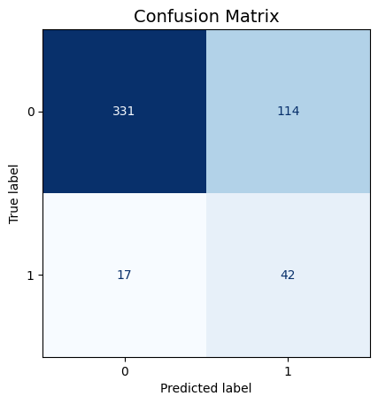
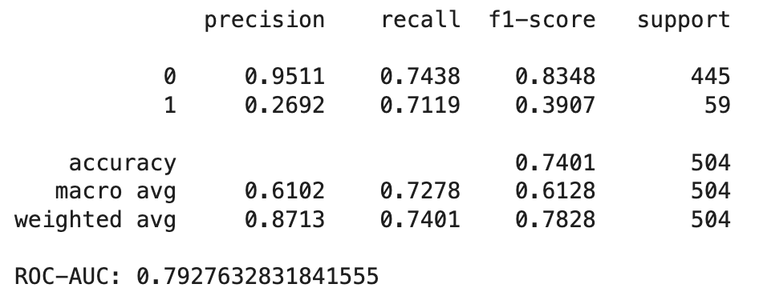
Rough Model Results (Logistic Regression)
ROC-AUC: 0.79
Can distinguish well between good and bad outcomes
For class 1, high recall and low precision
Catches most true positives but produces more false alarms

Slide 23
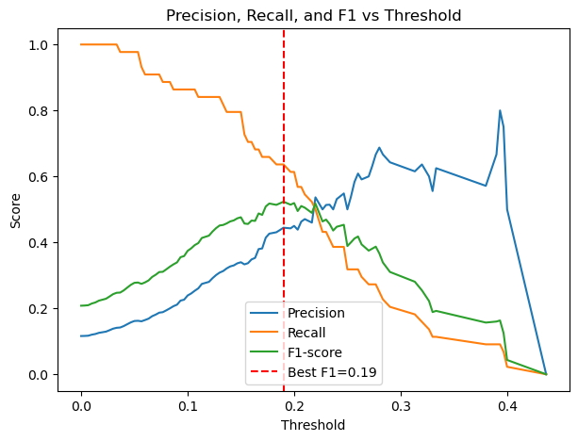
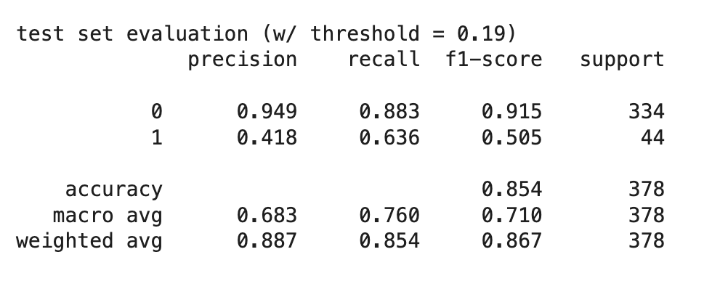
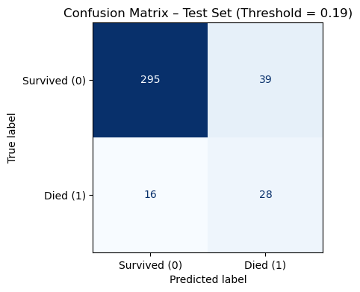
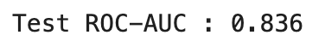
Fine-Tuning (Threshold = 0.19)
Detected 28 out of 44 actual deaths
Missed 16 deaths so there are still some false negatives
39 false positives means model flags survivors as high risk
ROC-AUC 0.84: model can strongly discriminate between outcomes

Slide 24
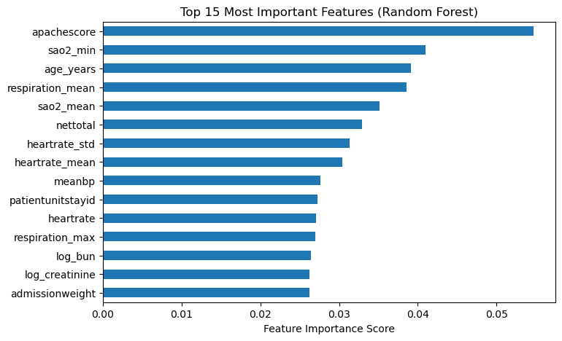

Slide 25
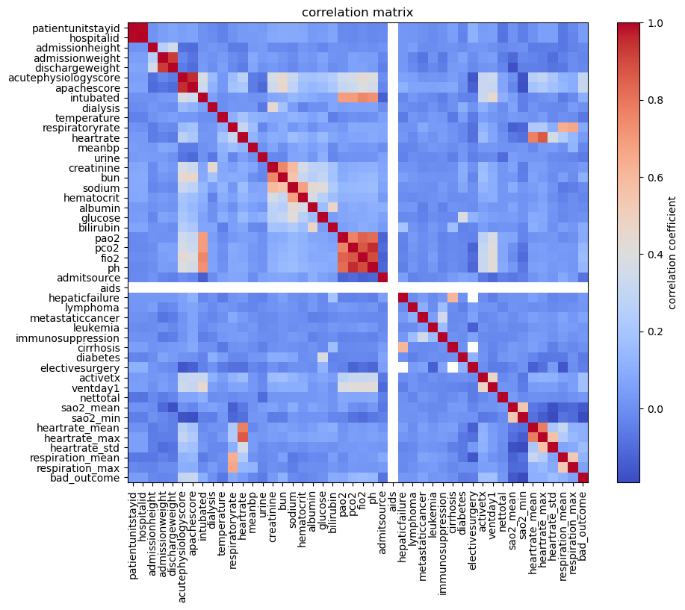
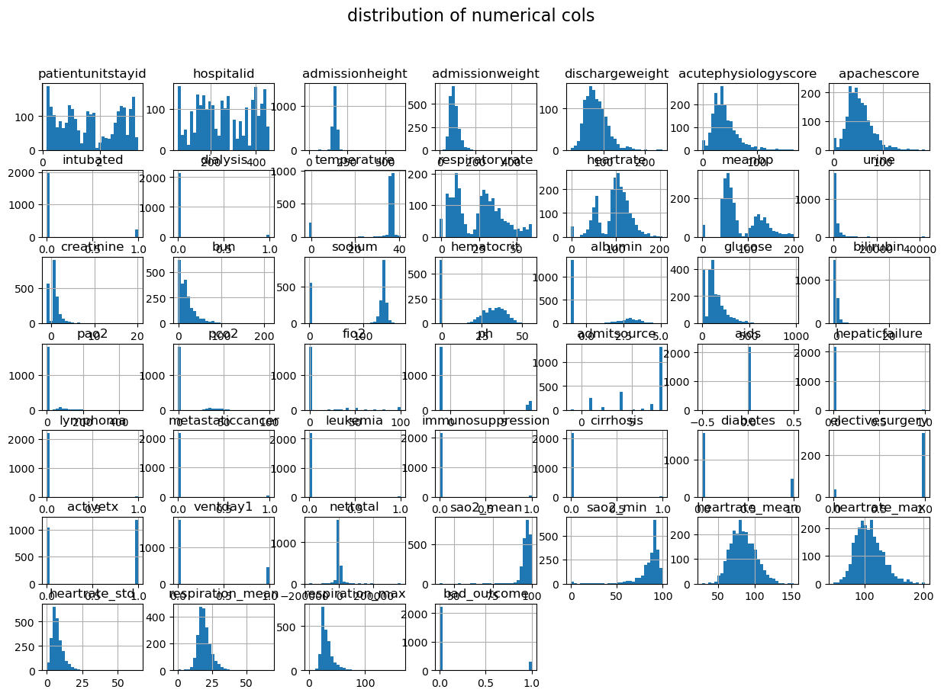
What we’ll work on now
Officially choose which merged dataset to go with
Figure out what to do with our null values (probably implement an “Unknown” variable)
Do a thorough analysis (EDA) and proper cleaning of our data now that we have a data frame created
How to handle outliers
How to handle multicollinearity
Explore fine tuning
Look forward to fairness checks

Slide 26




Contact Us!
Alain Areeba Siddiqui
axs6903@mavs.uta.edu
Mariah Noelle Cornelio
mnc3287@mavs.uta.edu
Darlene Eligado
dae9134@mavs.uta.edu

Slide 27
Thank You!
This template has been created by Slidesgo

